Slide 1


Flutter
“Beyond Hello World”
By Scott Stoll
A number of these slides were shamelessly stolen with
permission from Ahmed Abu Eldahab (Flutter Egypt) and Pascal Welsch
@scottstoll2017

Slide 2

What is Flutter?
What is Flutter?
flutter.io
flutter.io
A multi-platform mobile app SDK
●
A multi-platform mobile app SDK
●
for Android, iOS and Fuchsia
for Android, iOS and Fuchsia
Uses Dart - compiles to efficient ARM code
●
Uses Dart - compiles to efficient ARM binary
●
Rich Widget catalog
●
Rich Widget catalog
●
Modern, React inspired View-Framework
●
Modern, React inspired View-Framework
●
Notes:
It’s cross platform because it runs on multiple platforms but that’s actually a side effect of the approach.
.
It’s designed to take over the device and render straight to the canvas. It was only after playing with this idea in that they realized it would actually work cross platform.
.
No JVM. In fact, in production code there is no VM, as long as you aren’t counting the techniques needed to access the physical ram, etc. That doesn’t count as what we call a VM.
.
Widgets, widgets everywhere.

Slide 3
Flutter goals
●
Builds beautiful, fluid UIs
●
High-performance apps that feel natural on
different platforms
●
Rapid prototyping let’s you experiment freely.
●
Runs the same UI on multiple platforms, perfect
for custom branded designs
Notes:
Because of the approach, you can build UI’s that are only limited by your imagination. You’re not limited to the OEM widgets.
.
Can’t distinguish the UI from it’s OEM conterpart
.
Hot reload and hot restart can let you try 3, 4, 5 variations in a single minute.
.
Can make the UI look identical everywhere.

Slide 4

What makes Flutter unique?
Compiles to Native Code (ARM Binary code)
Not reliant on OEM widgets
Unlike React, there’s no bridge needed
No VM in the release code to slow things down
Debug builds are JIT compiled, allowing for Rapid Prototyping
Flutter
Notes:
Release code is AOT for running fast
Debug code is JIT for coding fast
.
Doesn’t use OEM widgets, but does deceive you into thinking it does.
.
No bridge to slow things down
.
There is no JVM because there is no Java
.
Little left… no, a little right. Is it crooked? I think it’s crooked… what about blue? I like blue...

Slide 5
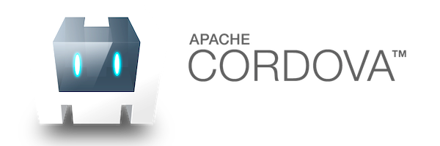



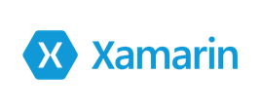


Mobile Development Approaches
JavaScript
C#
JavaScript
JavaScript

Slide 6
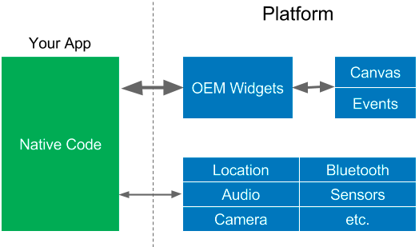
OEM SDKs

Slide 7
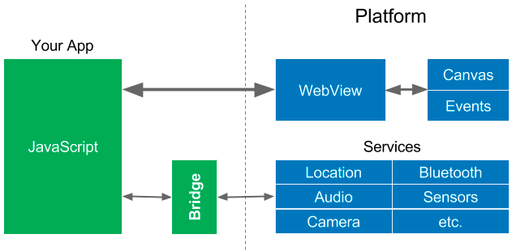
WebViews

Slide 8
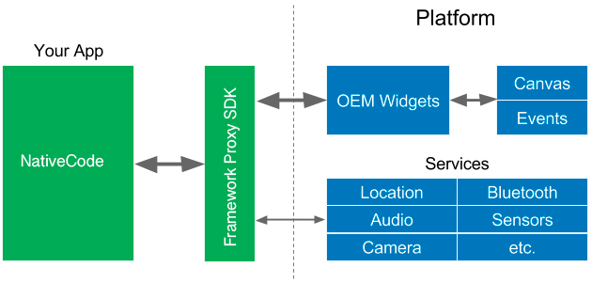
Native Proxy SDK

Slide 9

Reactive Views

Slide 10

Flutter’s Approach
Google Flutter

Slide 11
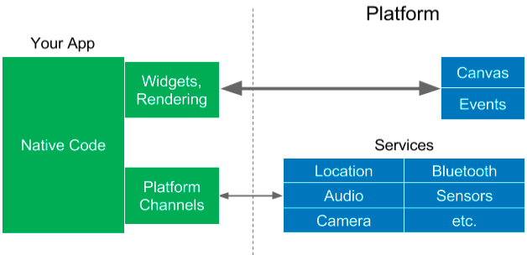
Flutter approach
Notes:
Platform Channels are needed to access services but they also allow you to use any part of the underlying framework you want. You could put a recyclerView inside of a flutter UI if you wanted to.
.
UNDER THE HOOD
Android launches an activity called Flutter Activity and runs it like any other app. For graphics it creates a SurfaceView and draws directly to a GPU Texture.
In iOS Flutter uses UI View Controller.

Slide 12
App
Platform OS
Canvas
OEM Widgets
Input Events
React Native
JavaScript
Bridge
System Services
(Location, Bluetooth, Audio, Camera,
Sensors, etc.)
Canvas
Widget
Rendering
Input Events
Flutter
Dart ARM
code
System Services
Platform
(Location, Bluetooth, Audio, Camera,
Channels
Sensors, etc.)
All Native Binary! NO JS. NO VM.

Slide 13


Dart?
dartlang.org

Slide 14


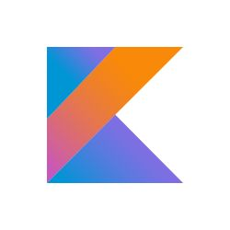


The History of
“We can rebuild him.
We have the technology.
Make him stronger, faster, better than he was before...”
“Dart is Dead”
“Dart Sucks!”
“NOBODY uses Dart”
2011
2013
2014
2015
2018
Goal:
Dart 1.0
No Dart
for Chrome!
Fail Whale!
Roadmap: Dart
Compile to
Dart 2.0
Replace
2.0 announced
ARM
dev preview
JavaScript in
JIT only
for
Chrome.
Rule the
World!
early 2016
Make Dart and tools
Move to AOT
multiplatform
Introduce Strong mode;
async/await
Web, mobile, Dart VM

Slide 15

What is Dart?
Open-source web programming language developed by Google.
Class-based, single-inheritance with mixins, object oriented language with C-style syntax.
Supports interfaces, abstract classes, reified generics, and optional typing(Dart 1) and strong typing (Dart 2)..
One language to rule them all..
Notes:
Mixins make it possible to use parts of other classes without needing to have a huge inherited tree.
.
.
Mixins are multiple inheritance with some constraints
C++ for example allows multiple inheritance, but that can lead to some pretty hard to understand constructs.
.
.
Multiple Inheritance:
class Cat extends Animal, Toy {}
.
.
In Dart there can only be a single superclass, but mixins can be added as well.
There is just a clear distinction what the superclass is and which classes are only mixed in.In Dart there are severe limitations how classes can look like to be allowed to be used as mixins.
.
.
class Cat extends Animal with Toy {}

Slide 16
Who use Dart?
Google AdWords
Google Fuchsia
Google Fiber
AdSense
performance reports
Mandrill
AdWords for video
Google internal sales tool
Google internal CRM
Adobe
https://www.dartlang.org/community/who-uses-dart
Notes:
Think about this:
AdWords and AdSense are Google’s cash cows. They’re the reason Google currently has more than one Billion dollars in cash.
Do you seriously think they would trust that to any language that sucks?

Slide 17
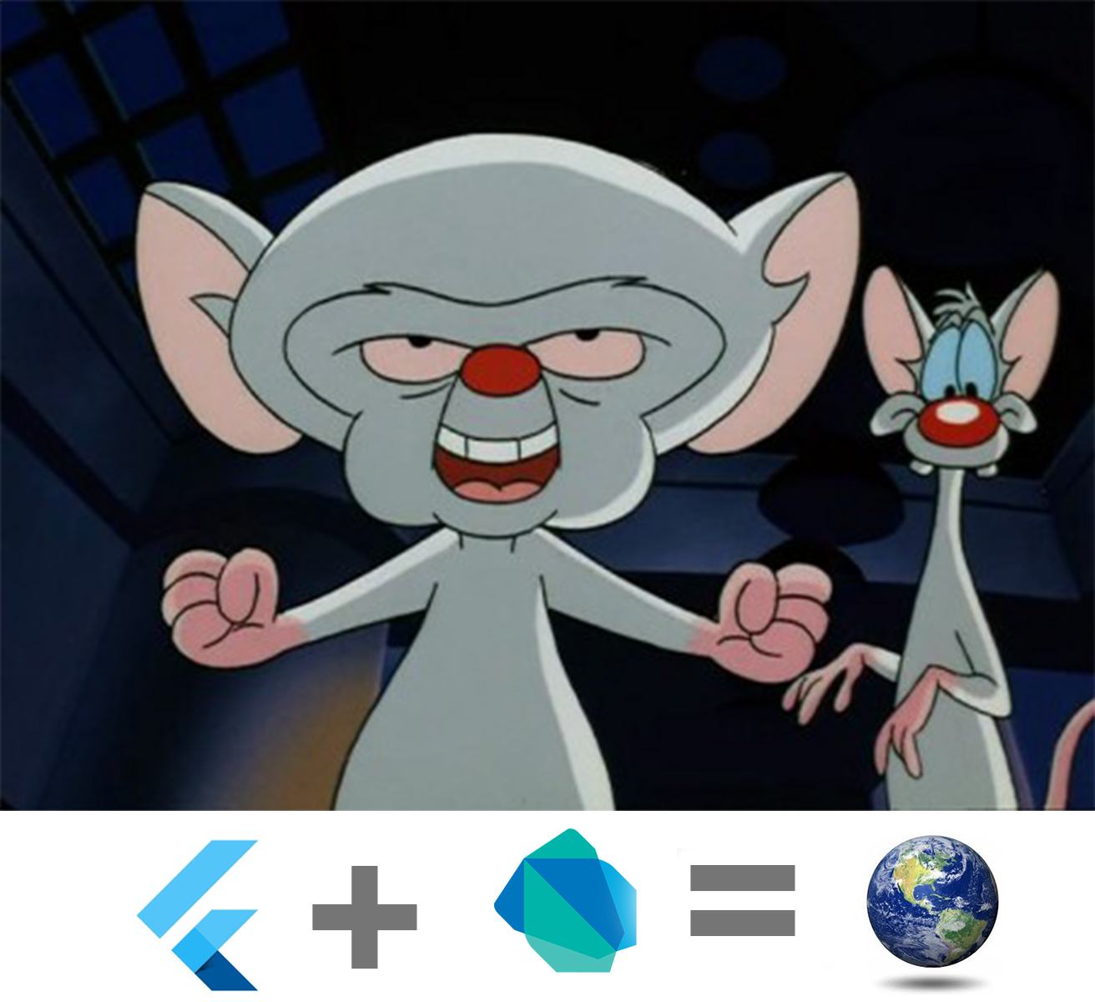
What’s next?
(They have a Secret Weapon)

Slide 18

Introducing:
Google Fuchsia
Fuchsia is a capability-based, real-time operating system (RTOS) currently being developed by Google.
https://github.com/fuchsia-mirror/
Notes:
Serve real-time applications that process data as it comes in, typically without buffer delays. Processing time requirements (including any OS delay) are measured in tenths of seconds or shorter increments of time.
.
A real time system is a time bound system which has well defined fixed time constraints. Processing must be done within the defined constraints or the system will fail.
.
They either are event driven or time sharing. Event driven systems switch between tasks based on their priorities while time sharing systems switch the task based on clock interrupts.
.
A key characteristic of an RTOS is the level of its consistency concerning the amount of time it takes to accept and complete an application's task; the variability is jitter.
.
Key factors in a real-time OS are minimal interrupt latency and minimal thread switching latency; a real-time OS is valued more for how quickly or how predictably it can respond than for the amount of work it can perform in a given period of time

Slide 19
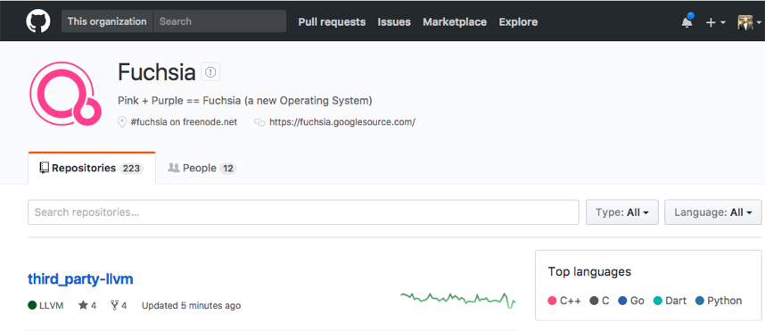

Google Fuchsia
https://github.com/fuchsia-mirror/
Notes:
Have you downloaded it yet?
Well, hurry up already...

Slide 20
So how does this work?
Flutter

Slide 21
Widget Rendering
App
Platform OS
Canvas
Widget
Rendering
Events
Flutter
Native
Flutter Code
System Services
Platform
(Location, Bluetooth, Audio, Camera,
Channels
Sensors, etc.)
Notes:
Widgets are inside your app, not in the device’s framework.
.
This means it doesn’t matter what the phone’s OS may have been limited to. Whatever widgets you can create in Flutter, that’s what’s going to show on your phone.

Slide 22
What are Widgets?
●
Widgets are immutable
class PaddedText extends StatelessWidget {
declarations of parts of the UI
final String _data;
●
Like a
<div/>
PaddedText(this._data, {Key key})
: super(key: key);
●
a structural element
@override
(e.g. button, menu)
Widget build(BuildContext context) {
return new Padding(
●
a stylistic element
padding: const EdgeInsets.all(4.0),
child: new Text(_data,
(themes, styles, fonts)
style:
const TextStyle(fontSize: 18.0))
●
an aspect of layout
);
}
(padding, center)
}
Notes:
A little in the weeds:
Notice that widgets are not actually the parts of the UI, they’re declarations of parts of the UI.
.
Like Twilight Zone, there are three planes of existance.
Widgets are like Blueprints
You instantiate them and the instances are called Elements. If you don’t specify a name, then a Key is used to identify individual instances.
Render objects.
.
You can unit test your UI Elements, not your UI widgets. You can’t test a blueprint, you have to test the car you build from it.

Slide 23
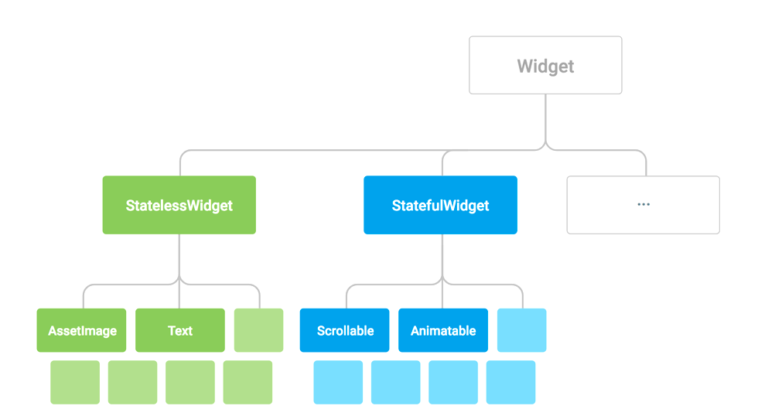
Everything is a Widget
Notes:
Every thing is a widget.
Text is a widget.
Padding is a widget
The whole app is one big widget.
Your dog is a widget

Slide 24

Mutation (evil)
Mutable View
val myText = new Button(context)
Button
// initialize
myText.text = “Enabled”
- onDraw(Canvas)
fun disableButton() {
- setText(String)
myText.text = “Disabled”
- setEnabled(Boolean)
myText.isEnabled = false
}
fun enableButton() {
myText.isEnabled = false
State
Render
}
// Q: What’s the button text after
// calling enableButton()?
!
Only the Button knows about its state
// A: undefined, depends on call order
Two responsibilities
- drawing
- owning state

Slide 25
Declaration
Mutable RenderObject
var _enabled = true;
State
“Button”RenderObject
@override
Widget build(BuildContext context) {
- paint(Canvas)
// Configure RenderObject for each possible state
- TextSpan text
return RaisedButton(
onPressed: _enabled ? () {...} : null,
child: Text(_enabled ? "Enabled" : "Disabled"),
);
}
Render
void disableButton() {
// change state
setState((){ _enabled = false; });
}
// Q: What’s the button text after
void enableButton() {
// calling enableButton()?
setState((){ _enabled = true; });
}
// A: “Enabled”
Notes:
BUT WE LIED!
Once it leaves your hands it stops being a widget.
There are elements and render objects.

Slide 26
Reactive layer
View Layer
var _enabled = true;
@override
Widget build(BuildContext context) {
// Configure RenderObject for each possible state
“Button”RenderObject
return RaisedButton(
onPressed: _enabled ? () {...} : null,
- paint(Canvas)
child: Text(_enabled ? "Enabled" :
State
- TextSpan text
"Disabled"),
);
Render tree
}
void disableButton() {
// change state
setState((){ _enabled = false; });
}
void enableButton() {
Render
setState((){ _enabled = true; });
}
Render
Widget tree
Element tree
Render
Widget
Diff
Update
Object
Widget
Widget
Rendering
Rendering
Widget
Widget
Rendering
Rendering
Widget
Widget
Rendering
Rendering
Rendering
Widget
Widget
Rendering
Rendering
Widget
Element
Widget
Rendering
Rendering
Widget
Widget
Rendering
Rendering
Widget

Slide 27
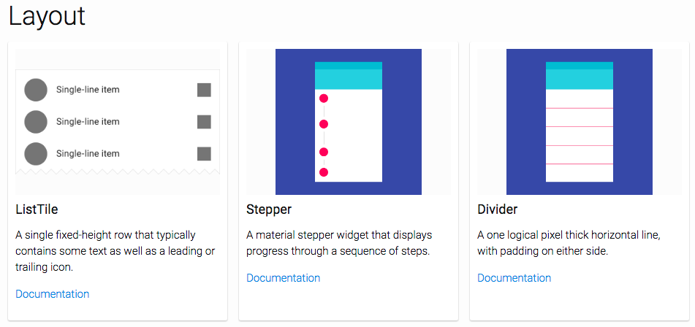
Widget Catalog, organized by type:
Widget Index, organized alphabetically:
https://flutter.io/widgets/
https://flutter.io/widgets/widgetindex/
Notes:
The documentation is fantastic. This makes it easy to find the widget you need and what to do with it.

Slide 28
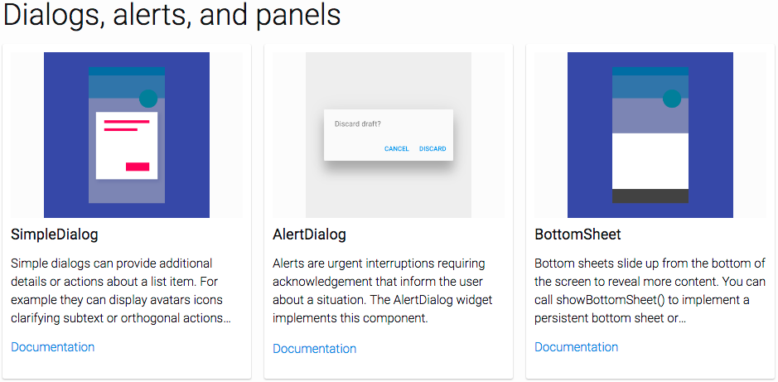
https://flutter.io/widgets/widgetindex/
Notes:
Pre-made dialogs, popups, tabbed menus and more make it easy.

Slide 29
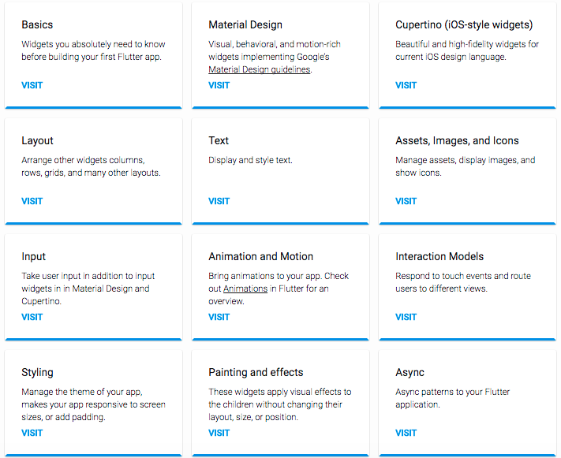
https://flutter.io/widgets/
Notes:
The widget catalog is easy to browse so you can find just what you need.
.
Have you ever tried to browse the Android documentation?

Slide 30
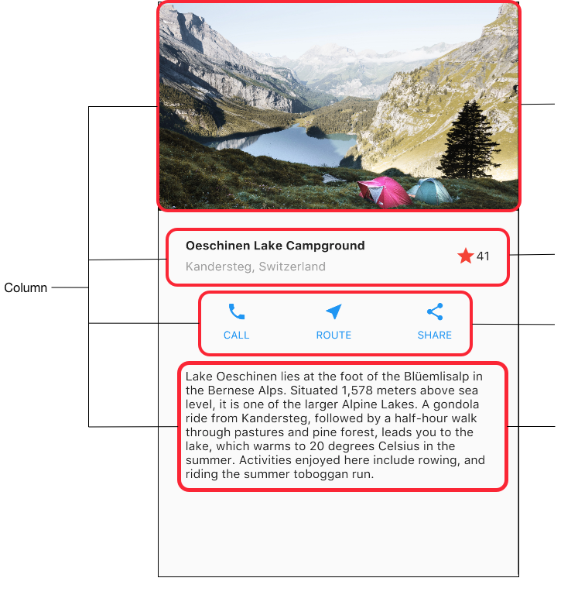
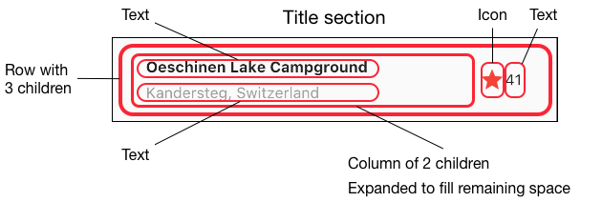
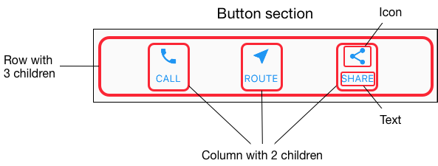
Rows and columns
Notes:
You can create UI components and reuse them.
.
You don’t need to use a table to lay everything out. There is a property called offset, that allows you to control exactly where a child is placed within its parent.

Slide 31
So how do I make
a different layout for
each screen size?

Slide 32
YOU DON’T HAVE TO!
No need to specify SP, DP etc

Slide 33
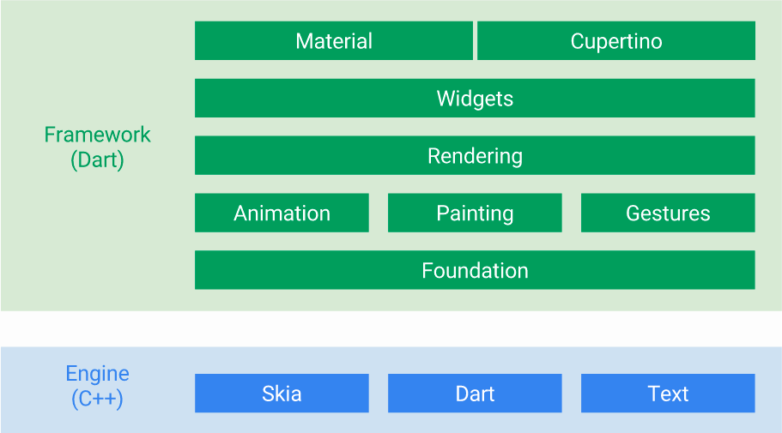
You Can customize everything in green
Notes:
Yes, foundation means the base of the SDK, right down to the definition of widget itself.
.
Though you supposedly can’t change text, you can change just about anything about it. From font family and size to line height, and you can even set font weight by w numbers rather than just “Normal”, “Bold” etc. IE: w300, w700, etc.

Slide 34
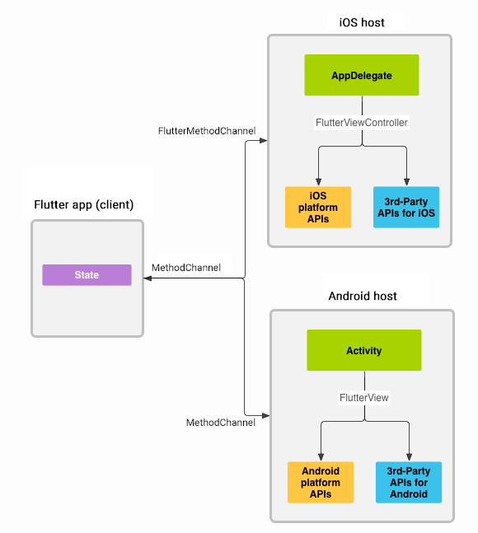
Platform channels
Flutter
https://flutter.io/platform-channels/

Slide 35
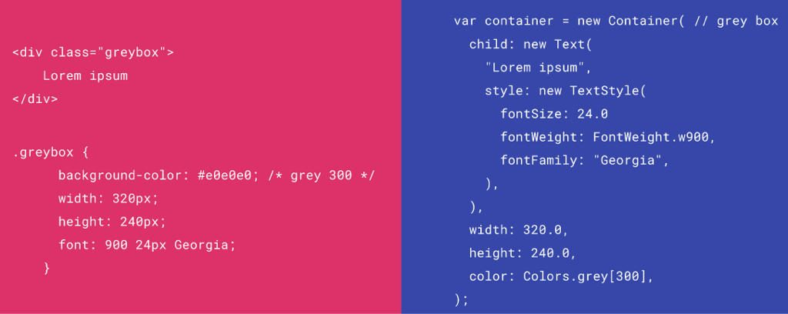
HTML/CSS Analogs in Flutter

Slide 36
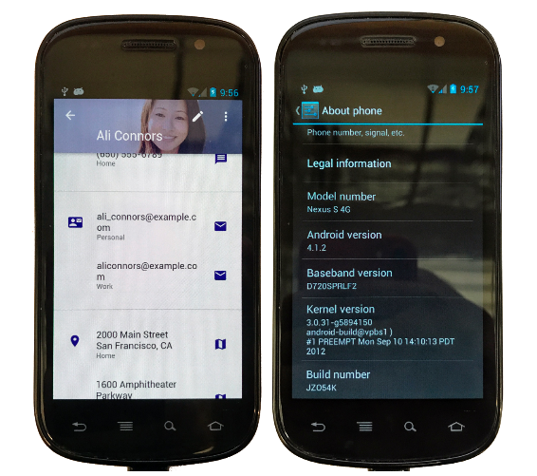
Consistent Material Design (or your design) on phones made way before Material Design existed
Notes:
Again because Flutter supplies it’s own widgets and draws directly to the GPU texture your user’s phone is no longer limited to the widgets that it came with.
.
You can make your app with Material Design or Human Interface compliant widgets and that’s exactly what your UX will provide, regardless of how old their phone is or what UI components it did or didn’t come with.

Slide 37





IDE Support ?

Slide 38
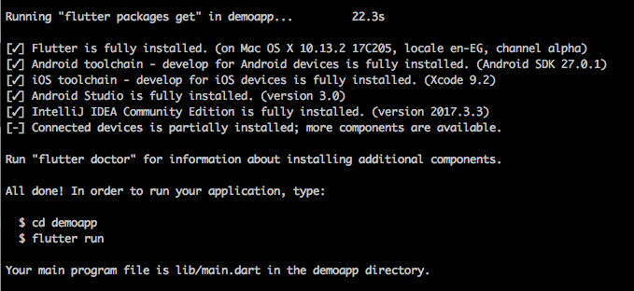
Terminal ?
$ flutter create demoapp

Slide 39
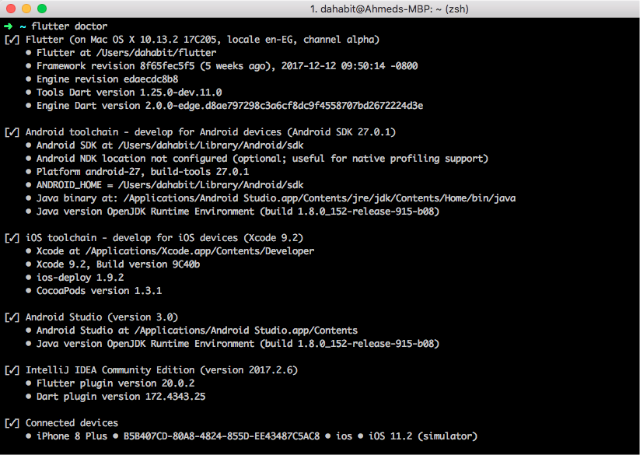
Easy Check !
$ flutter doctor

Slide 40
Over 200 Apps
are already on the Google Play Store!
(Did someone say not production ready?)

Slide 41
Alpha: Long, long ago in a galaxy far, far away…
Beta V1: February ‘18
Beta V2: March ‘18
Beta V3: April ‘18
Flutter “Preview” (RC1) JUNE 20th !!!!
Question:
How mature did Alpha have to be for things to move this fast?
Now you know whey many developers have been making production app with Alpha since 2016

